Slide 1
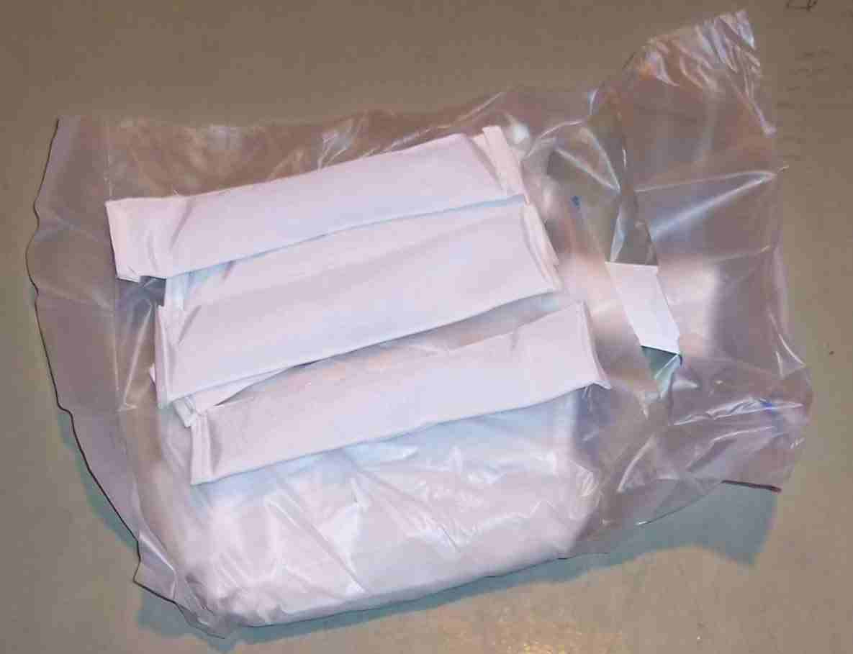
SIEMENS
HVCB SPARES
Filter material for Pole
72.5KV,31.5KA, CB
S4809239001

